Slide 1
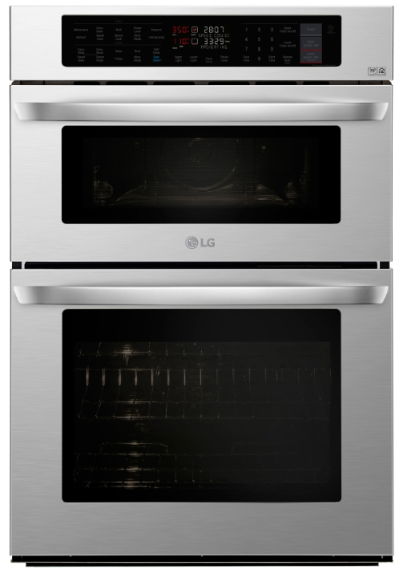
“Two Ovens with Four Ways to Cook!”
LWC3063ST
Wi-fi Enable Combination Double Wall Oven
Upper Oven
  No preheating required with the TurboCookTM Oven! The oven uses a powerful
  combination of Infrared Heating™, convection, and microwave to offer speeds
  2 to 4 times faster than a conventional oven.
Versatility
Lower Oven
  True Convection delivers continual, precise heat for even browning and crisping on
  every rack.
  Steam Cooking locks in moisture while still achieving a perfect golden brown—and is
  one of the healthiest way to cook for your family
Smart Features
  Use the SmartThinQ® app to start the oven, set timers or check on differ from anywhere.
  Access to thousands of recipes through SideChef and Innit apps, then automatically send temperatures and cook times to your oven.
  Select oven features work with Alexa and Google Assistant
Convenience
Model | Go-to | PG
LWC3063ST | $4,199 | $3,499
    Cleanability
      Keep your oven looking like new with EasyCean®. Get a spotless oven in just 10 minutes with the fastest oven-cleaning feature available– plus self-clean!

